Slide 1
NC_S100
S-100 Exchange set Builder
Inception Report

Slide 2
Project Inception
Project Overview
Team Foundation
Enterprise Alignment
Scope Exploration
Architecture Strategy
Release Planning
Test Strategy
Vision Development
Funding and Resources
Risks and Dependencies

Slide 3
Project Overview
Project Name: S-100 Exchange set builder.
Project Description: The S-100 discovery metadata for information exchange catalogues profile provides a specification for describing and creating exchange catalogues that enables users to identify, discover and manage content of the S-100 Exchange Sets. More importantly it leverages XML to allow machine to machine discovery and exchange of information about geographic datasets commonly produced by hydrographic organizations.

Slide 4
Team Foundation
Team members
# | Name | Role
1 | john | Project Manager
2 | rob | Project owner
Stakeholders
# | Name | Interests
1 | IIC-IC | Nautilus Cloud S-100 team

Slide 5
Enterprise Alignment
The enterprise goal of the Nautilus Cloud (NC) is to develop S-100 frame work with the complete set of toolsets such as web, desktop and mobile for managing all nautical products according to international hydrographic standards.
Develop suitable solutions by leveraging the domain experience, existing assets, technology, processes and knowledge to enhance the project efficiency and effectiveness.
Follows the established guidelines and standards to design and develop the nautical solutions.
The project aim to improve the organization's market position by introducing innovative S-100 products or services, thereby enhancing its competitive advantage

Slide 6
Scope Exploration
Project Scope:
The scope of the project is to design and develop a web application to manage the S-100 Exchange set by following the S-100 international hydrographic organization (IHO) standards.
Key Deliverables:
S-100 Exchange set Builder
S-100 Exchange set Builder APIs

Slide 7
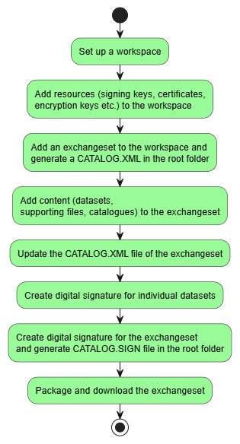
Flow diagram

Slide 8
Scope Exploration
Epics:
Workspace
Resources (signing keys, certificates, encryption keys)
Exchange set
Content (Datasets, Supporting files, Catalogues)

Slide 9
Scope Exploration
EPIC | Workspace
User Story ID | US - 1
User Story Name | Set up a workspace
User Story | As a data producer, I want to configure and define workspace location. So that I can organize my S-100 data assets, store temporary files, and ensure all operations (like creating/modifying exchange sets) occur within a designated and accessible directory.
Acceptance Criteria | Positive Scenario (Successful Workspace Configuration): Given the data producer is launching the application for the first time, or is in the application's "Settings" or "Preferences" section. When the data producer browses to and selects a valid and accessible directory on the local file system (or network share, if supported) as the desired workspace location. And the data producer confirms the selection (e.g., by clicking "Save" or "Apply"). Then the application successfully sets and stores the chosen directory as the active workspace location. And the application creates any necessary internal subdirectories within the chosen workspace (e.g., for temporary files, logs, exchange set storage) if they don't already exist. And the data producer receives a clear confirmation message that the workspace has been successfully configured. And subsequent application operations (e.g., creating a new exchange set) default to or are confined within this defined workspace. And the configured workspace path is persisted across application restarts. Negative Scenarios (Failure/Error Conditions): Scenario 1: No Workspace Selected (Initial Launch) Given the application is launched for the first time and no workspace has been configured. When the data producer attempts to proceed without selecting a workspace or closes the workspace configuration prompt without saving. Then the application prevents further critical operations (e.g., "Create New Exchange Set" is disabled), displays a prominent message instructing the user to define a workspace, and may redirect them to the settings. Scenario 2: Invalid or Non-Existent Path Selected Given the data producer is configuring the workspace. When the data producer enters or selects a path that does not exist or is an invalid file system path (e.g., contains illegal characters, is a malformed URL). Then the application prevents the selection, displays a specific error message (e.g., "Invalid Path," "Directory does not exist"), and does not set the workspace. Scenario 3: Insufficient Write Permissions to Selected Path Given the data producer is configuring the workspace. When the data producer selects an existing directory where the application (or the user running it) does not have sufficient write permissions to create files or subdirectories. Then the application prevents the selection, displays a specific error message (e.g., "Permission Denied: Cannot write to selected directory"), and does not set the workspace. Scenario 4: Workspace Becomes Inaccessible After Configuration Given a workspace has been successfully configured and the application is restarted. When the previously configured workspace path becomes inaccessible (e.g., network drive disconnected, external drive removed, directory deleted/renamed externally). Then upon launch or when an operation requiring the workspace is attempted, the application detects the inaccessibility, displays a prominent error message (e.g., "Workspace not found or inaccessible"), and prompts the user to reconfigure the workspace. Scenario 5: Disk Space Issues (during sub-directory creation/initialization) Given a data producer selects a valid directory as the workspace. When there is insufficient disk space in the chosen location to create the necessary initial subdirectories or temporary files. Then the application fails to configure the workspace, displays an error message indicating insufficient disk space, and does not set the workspace.

Slide 10
Scope Exploration
EPIC | Resources
User Story ID | US - 2
User Story Name | Add resources to the workspace
User Story | As a data producer, I want to securely add and manage supporting resources like signing keys, certificates, and encryption keys within my workspace, so that I can easily access and consistently apply them when creating, signing, encrypting, or modifying S-100 exchange sets and their content.
Acceptance Criteria | Positive Scenario (Success Path): Given a data producer is in the workspace settings or a dedicated "Resource Management" section, When the data producer selects to add a new resource (e.g., "Add Signing Key"), provides a valid file path or input for the key/certificate/encryption key, and confirms the addition, Then the application validates the resource's format and integrity, securely stores/registers it within the workspace environment, makes it available for relevant operations, And provides a confirmation of successful addition. Negative Scenarios (Failure Paths / Edge Cases): Scenario 1: Invalid File Format or Corrupted Resource Given a data producer attempts to add a resource, When the file provided is not in a recognized format for the specified resource type (e.g., a text file instead of a .pem certificate, or a corrupted key file), Then the system prevents the addition, displays an error message indicating an invalid format or corruption, and the resource is not stored. Scenario 2: Duplicate Resource Given a data producer attempts to add a resource, When the exact same key, certificate, or encryption key (identified by its unique properties) already exists within the workspace, Then the system prevents the addition, displays a message indicating that the resource already exists, and the existing resource remains unchanged. Scenario 3: Expired or Revoked Certificate (for certificates) Given a data producer attempts to add a certificate, When the certificate is found to be expired or has been revoked during the validation process, Then the system prevents the addition, displays a warning or error message about the certificate's status, and the certificate is not stored. Scenario 4: Insufficient Permissions to Store Resource Given a data producer attempts to add a resource, When the application lacks the necessary file system permissions to securely store the resource within the workspace's designated storage area, Then the system prevents the addition, displays a permission-denied error message, and the resource is not stored. Scenario 5: System Error During Storage/Registration Given a data producer provides a valid resource, When an unexpected system error occurs during the process of storing or registering the resource (e.g., database connection failure, disk write error), Then the resource is not added, an appropriate error message is displayed, and the system logs the error for investigation.

Slide 11
Scope Exploration
EPIC | Exchange set
User Story ID | US - 3
User Story Name | Add an exchange set to the workspace
User Story | As a data producer, I want to generate an S-100 exchange set container, so that I can efficiently manage required content (datasets, supporting files, catalogues), package them, and securely share them with end-users in compliance with the S-100 standard.
Acceptance Criteria | Positive Scenario (Successful Creation): Given a data producer is on the "Create New Exchange Set" form, When the data producer provides a valid and unique name for the exchange set, provides a valid authentication key, and confirms the creation of an S-100 exchange set, Then an empty S-100 exchange set container is successfully created with a valid folder structure in compliance with the standards in the designated workspace. And a CATALOG.XML file is generated in the S100_ROOT directory of the new exchange set. And the CATALOG.XML is automatically validated against its S-100 schema and is confirmed to be schema-compliant. And the data producer receives a clear confirmation message upon successful creation. Negative Scenarios (Failure/Error Conditions): Scenario 1: Invalid Exchange Set Name Given a data producer is on the "Create New Exchange Set" form, When the data producer provides an invalid name (e.g., empty, containing disallowed characters, exceeding length limits) and attempts to create an S-100 exchange set, Then the system prevents creation, displays a specific and informative error message indicating the naming issue, and the form remains active for correction. Scenario 2: Duplicate Exchange Set Name Given an S-100 exchange set with a specific name already exists in the workspace, and a data producer is on the "Create New Exchange Set" form, When the data producer attempts to create a new S-100 exchange set using that existing name, Then the system prevents creation, displays a clear error message stating that the name is already in use, and the form remains active. Scenario 3: Invalid or Missing Authentication Key Given a data producer is on the "Create New Exchange Set" form, When the data producer provides an invalid, expired, or incorrect authentication key (or no key if required) and attempts to create an S-100 exchange set, Then the system prevents creation, displays a specific error message related to the authentication key's validity or requirement, and the form remains active for correction. Scenario 4: Workspace Issues (e.g., Permissions, Disk Space) Given a data producer attempts to create an S-100 exchange set, When there are insufficient write permissions in the workspace directory, or insufficient disk space to create the new exchange set container and its files, Then the system prevents creation, displays an appropriate error message (e.g., "Permission Denied," "Insufficient Disk Space"), and no exchange set is created. Scenario 5: System Error During Creation Given a data producer provides valid inputs for creating an S-100 exchange set, When an unexpected system error occurs during the creation of the folder structure or the CATALOG.XML file (e.g., file system error, internal service failure), Then the exchange set is not created (or any partially created files/folders are rolled back/cleaned up), an appropriate general error message is displayed to the data producer, and the system logs the detailed error for investigation.

Slide 12
Scope Exploration
EPIC | Content
User Story ID | US - 4
User Story Name | Add or Remove dataset(s) to the exchange set
User Story | As a data producer, I want to add dataset like ENC, HDF5 etc. to an existing S-100 exchange set, so that I can assemble a complete data package for distribution and ensure the exchange set's manifest is up-to-date.
Acceptance Criteria | Positive Scenario (Success Path): Given a data producer has opened an editable S-100 exchange set and has browsed available datasets, When the data producer selects one or more valid datasets and chooses the "Add" or “Remove” option, Then the selected datasets are successfully added to the designated folders in the exchange set container, And the CATALOG.XML file is automatically updated to reflect the newly added datasets, And the producer receives a confirmation of success. Negative Scenarios (Failure Paths / Edge Cases): Scenario 1: Adding Duplicate datasets Given a data producer has opened an exchange set that already contains a specific dataset, When the data producer attempts to add the exact same dataset (duplicate) to the exchange set again, Then the system prevents the addition, displays a message indicating that the dataset is already exists in the exchange set, and the CATALOG.XML is not modified. Scenario 2: Exchange Set is Not Editable/Locked Given a data producer attempts to add dataset to an exchange set that is locked, read-only, or in a finalized state (e.g., already packaged for distribution), When the data producer tries to select and add dataset, Then an error message is displayed indicating that the exchange set cannot be modified in its current state. Scenario 3: System Error During Addition/Catalog Update Given a data producer selects valid dataset to add, When an unexpected system error occurs during the process of adding dataset or updating the CATALOG.XML (e.g., file write error, database issue), Then the datasets are not added, the CATALOG.XML remains in its previous valid state (or is rolled back), an appropriate error message is displayed, and the system logs the error.

Slide 13
Scope Exploration
EPIC | Content
User Story ID | US - 5
User Story Name | Add or Remove supporting files to the exchange set
User Story | As a data producer, I want to add supporting files like TXT, PDFs etc. to an existing S-100 exchange set, so that I can assemble a complete data package for distribution and ensure the exchange set's manifest is up-to-date.
Acceptance Criteria | Positive Scenario (Success Path): Given a data producer has opened an editable S-100 exchange set and has browsed available supporting files, When the data producer selects one or more valid supporting files and chooses the "Add" or “Remove” option, Then the selected supporting file are successfully added to the exchange set container, And the CATALOG.XML file is automatically updated to reflect the newly added products, And the producer receives a confirmation of success. Negative Scenarios (Failure Paths / Edge Cases): Scenario 1: Adding Duplicate Supporting files Given a data producer has opened an exchange set that already contains a specific supporting file, When the data producer attempts to add the exact same supporting file (duplicate) to the exchange set again, Then the system prevents the addition, displays a message indicating that the supporting file is already exists in the exchange set, and the CATALOG.XML is not modified. Scenario 2: Exchange Set is Not Editable/Locked Given a data producer attempts to add supporting file to an exchange set that is locked, read-only, or in a finalized state (e.g., already packaged for distribution), When the data producer tries to select and add supporting file, Then an error message is displayed indicating that the exchange set cannot be modified in its current state. Scenario 3: System Error During Addition/Catalog Update Given a data producer selects valid supporting file to add, When an unexpected system error occurs during the process of adding supporting file or updating the CATALOG.XML (e.g., file write error, database issue), Then the supporting files are not added, the CATALOG.XML remains in its previous valid state (or is rolled back), an appropriate error message is displayed, and the system logs the error.

Slide 14
Scope Exploration
EPIC | Content
User Story ID | US - 6
User Story Name | Add or Remove catalogues to the exchange set
User Story | As a data producer, I want to add product catalogues to an existing S-100 exchange set, so that I can assemble a complete data package for distribution and ensure the exchange set's manifest is up-to-date.
Acceptance Criteria | Positive Scenario (Success Path): Given a data producer has opened an editable S-100 exchange set and has browsed available product catalogues, When the data producer selects one or more valid products and chooses the "Add" or “Remove” option, Then the selected product catalogues are successfully added to the exchange set container, And the CATALOG.XML file is automatically updated to reflect the newly added products, And the producer receives a confirmation of success. Negative Scenarios (Failure Paths / Edge Cases): Scenario 1: Adding Duplicate Product Catalogue Given a data producer has opened an exchange set that already contains a specific product catalogue, When the data producer attempts to add the exact same product catalogue (duplicate) to the exchange set again, Then the system prevents the addition, displays a message indicating that the product catalogue is already exists in the exchange set, and the CATALOG.XML is not modified. Scenario 2: Exchange Set is Not Editable/Locked Given a data producer attempts to add product catalogue to an exchange set that is locked, read-only, or in a finalized state (e.g., already packaged for distribution), When the data producer tries to select and add product catalogue, Then an error message is displayed indicating that the exchange set cannot be modified in its current state. Scenario 3: System Error During Addition/Catalog Update Given a data producer selects valid product catalogue to add, When an unexpected system error occurs during the process of adding product catalogue or updating the CATALOG.XML (e.g., file write error, database issue), Then the product catalogues are not added, the CATALOG.XML remains in its previous valid state (or is rolled back), an appropriate error message is displayed, and the system logs the error.

Slide 15
EPIC | Content
User Story ID | US - 7
User Story Name | Create digital signature for individual datasets
User Story | As a data producer, I want to digitally sign individual elements within an S-100 exchange set, so that I can verify the authenticity and integrity of each specific data product for end-users, even if the overall exchange set isn't (yet) signed, or to provide an additional layer of trust.
Acceptance Criteria | Positive Scenario (Successful Element Signing): Given a data producer has opened an editable S-100 exchange set and has selected one or more valid, unsigned elements (e.g., data products, metadata files) within it. When the data producer provides a valid signature type, provides a valid authentication key, and then confirms the "Sign" option for the selected element(s). Then for each selected element, the system successfully applies the digital signature. And a .sign file (or equivalent signature artifact, as per S-100 specifications) is successfully generated for each signed element, stored alongside the element or otherwise associated within the exchange set structure. And the data producer receives a clear confirmation message upon successful signing of the element(s). Negative Scenarios (Failure/Error Conditions): Scenario 1: Element Already Signed Given a data producer selects an element within an exchange set that already contains a valid digital signature. When the data producer attempts to "Sign" it again. Then the system prevents re-signing, displays an informative message (e.g., "Element is already signed" or "Element must be unsigned before re-signing"), and the existing signature artifact remains unchanged. Scenario 2: Element Incomplete/Invalid for Signing Given a data producer selects an element that is incomplete, corrupted, or otherwise invalid/unsuitable for digital signing (e.g., an unreadable file, a non-standard S-100 element type that cannot be individually signed). When the data producer attempts to "Sign" it. Then the system prevents signing, displays a specific error message indicating the reason for invalidity (e.g., "Element data is corrupted," "Unsupported element type for individual signing"), and no signature artifact is generated. Scenario 3: Invalid, Expired, or Revoked authentication Key Given a data producer selects an element for signing. When the authentication key provided is invalid OR is invalid, expired, or revoked during the validation process. Then the system prevents signing, displays a specific error message related to the key (e.g., "Invalid authentication Key,“) and no signature artifact is generated. Scenario 4: Invalid or Missing Signature Type Given a data producer selects an element for signing. When the data producer provides an invalid or unsupported signature type, or fails to provide a required signature type. Then the system prevents signing, displays a specific error message about the invalid/missing signature type, and no signature artifact is generated. Scenario 5: Exchange Set (or Element) Not Editable/Locked Given a data producer attempts to sign an element within an exchange set that is locked, read-only, or in a finalized state (e.g., the exchange set itself is signed and locked, or archived). When the data producer tries to select and sign an element. Then the "Sign" option for individual elements is disabled or greyed out, or an error message is displayed indicating that the exchange set/element cannot be modified/signed in its current state. Scenario 6: Insufficient Permissions to Write Signature File Given a data producer selects an element for signing. When the application lacks the necessary file system permissions to write the signature file for the element to its required location within the exchange set. Then the system fails to generate the signature file, displays a permission-related error message (e.g., "Access Denied: Cannot write signature file"), and the signing process fails. Scenario 7: System Error During Signing Process Given a data producer provides valid inputs and selects elements for signing. When an unexpected system error occurs during the digital signature generation (e.g., cryptographic library failure, disk I/O error, memory allocation issue). Then the element(s) are not signed, no signature artifact is generated (or any partially created file is cleaned up), an appropriate general error message is displayed, and the system logs the detailed error for investigation.
Scope Exploration

Slide 16
Scope Exploration
EPIC | Exchange set
User Story ID | US - 8
User Story Name | Create digital signature for the exchange set
User Story | As a data producer, I want to generate a digital signature for the S-100 exchange set, so that I can ensure its authenticity, integrity, and non-repudiation before distribution, providing trust to end-users as per the S-100 standard.
Acceptance Criteria | Positive Scenario (Successful Signing): Given a data producer has selected a complete, valid, and unsigned S-100 exchange set that is ready for signing (i.e., not actively being modified), When the data producer selects the exchange set, provides a valid authentication key, provides a valid private key, provides a valid corresponding certificate, and confirms the "Sign" action, Then a CATALOG.SIGN file is successfully generated using the provided private key and certificate. And the CATALOG.SIGN file is added to the root folder of the exchange set. And the data producer receives a clear confirmation message upon successful signing. Negative Scenarios (Failure/Error Conditions): Scenario 1: Exchange Set Already Signed Given a data producer selects an exchange set that already contains a valid CATALOG.SIGN file, When the data producer attempts to "Sign" it again, Then the system prevents re-signing, displays an informative message (e.g., "Exchange Set is already signed" or "Exchange Set must be unsigned before re-signing"), and the existing CATALOG.SIGN file remains unchanged. Scenario 2: Exchange Set Incomplete/Invalid for Signing Given a data producer selects an exchange set that is incomplete (e.g., missing mandatory content), corrupted, or fails S-100 validation checks required before signing, When the data producer attempts to "Sign" it, Then the system prevents signing, displays a specific error message indicating the reason for invalidity (e.g., "Exchange Set is incomplete," "Validation failed: X"), and no CATALOG.SIGN file is generated. Scenario 3: Invalid, Expired, or Revoked Private Key/Certificate Given a data producer selects an exchange set for signing, When the private key provided is invalid, inaccessible, or does not correspond to the certificate, OR the certificate is invalid, expired, or revoked, Then the system prevents signing, displays a specific error message related to the key/certificate issue (e.g., "Invalid Private Key," "Certificate Expired," "Certificate Revoked"), and no CATALOG.SIGN file is generated. Scenario 4: Invalid or Missing Authentication Key (if distinct from signing credentials) Given a data producer selects an exchange set for signing, When the authentication key provided is incorrect, missing, or invalid for the user's role or the signing process, Then the system prevents signing, displays an authentication failure message, and no CATALOG.SIGN file is generated. Scenario 5: Exchange Set is Locked or Actively Modified Given a data producer attempts to sign an exchange set, When the exchange set is currently locked by another process or user, or is in an active modification state, Then the system prevents signing, displays a message indicating that the exchange set is busy or locked, and suggests trying again later. Scenario 6: System Error During Signing Process Given a data producer provides valid inputs and selects an exchange set for signing, When an unexpected system error occurs during the digital signature generation (e.g., cryptographic library failure, disk write error, memory allocation issue), Then the exchange set is not signed, no CATALOG.SIGN file is generated (or any partially created file is cleaned up), an appropriate general error message is displayed, and the system logs the detailed error for investigation.

Slide 17
Scope Exploration
EPIC | Exchange set
User Story ID | US - 9
User Story Name | Package and download the exchange set
User Story | As a data producer, I want to package an S-100 exchange set into a single compressed .zip file, so that I can efficiently transfer the complete, standardized data package to clients and ensure its integrity during distribution.
Acceptance Criteria | Positive Scenario (Successful Packaging): Given a data producer has selected a valid, complete, and finalized S-100 exchange set that is ready for packaging. When the data producer provides a valid authentication key, specifies a valid and accessible destination folder, and selects the "Package" option. Then a single .zip file is successfully generated in the specified destination folder. And the .zip file contains the entire S-100 exchange set structure (including all products, CATALOG.XML, and CATALOG.SIGN if present) at its root. And the .zip file is named according to a specified convention (e.g., based on exchange set name). And the data producer receives a clear confirmation message of successful packaging, along with the exact location of the generated file. Negative Scenarios (Failure/Error Conditions): Scenario 1: Exchange Set Incomplete/Invalid for Packaging Given a data producer selects an exchange set that is incomplete (e.g., missing mandatory files), corrupted, or fails S-100 validation checks required before packaging. When the data producer attempts to package it. Then the system prevents packaging, displays a specific error message indicating the reason for invalidity (e.g., "Exchange Set is incomplete," "Validation failed: X"), and no .zip file is generated. Scenario 2: Invalid or Missing Authentication Key Given a data producer selects an exchange set for packaging. When the authentication key provided is incorrect, missing, or invalid for the user's role or the packaging process. Then the system prevents packaging, displays an authentication failure message, and no .zip file is generated. Scenario 3: Invalid or Inaccessible Destination Folder Given a data producer selects an exchange set for packaging. When the specified destination folder is non-existent, invalid, or the application (or user) lacks sufficient write permissions to it. Then the system prevents packaging, displays a specific error message related to the destination (e.g., "Invalid Path," "Access Denied: Cannot write to folder"), and no .zip file is generated. Scenario 4: Exchange Set is Locked or Actively Modified Given a data producer attempts to package an exchange set. When the exchange set is currently locked by another process or user, or is in an active modification state that prevents consistent reading of its contents. Then the system prevents packaging, displays a message indicating that the exchange set is busy or locked, and suggests trying again later. Scenario 5: System Error During Compression Given a data producer provides valid inputs and selects an exchange set for packaging. When an unexpected system error occurs during the file compression process (e.g., I/O error, unexpected internal compression library failure, memory allocation issue). Then the exchange set is not packaged, no .zip file is generated (or any partially created file is cleaned up), an appropriate general error message is displayed, and the system logs the detailed error for investigation.

Slide 18
Scope Exploration
EPIC | Exchange set
User Story ID | US - 10
User Story Name | Delete exchange set from workspace
User Story | As a data producer, I want to easily identify and delete unused exchange sets from my workspace, so that I can maintain a clean and organized environment and avoid clutter.
Acceptance Criteria | Positive Scenario (Successful Packaging): Given a data producer views a list of exchange sets in their workspace, When the data producer selects one or more unused exchange sets and chooses to delete them, Then the selected exchange sets including all their contents and associated files, are permanently and irrecoverably removed from the workspace storage. And the deleted exchange sets are no longer visible in the list of available exchange sets. And the data producer receives a clear confirmation message indicating successful deletion. Negative Scenarios (Failure/Error Conditions): Scenario 1: Exchange Set is Locked or Actively Modified Given a data producer attempts to delete an exchange set. When the exchange set is currently locked by another process or user, or is in an active modification state that prevents consistent reading of its contents. Then the system prevents packaging, displays a message indicating that the exchange set is busy or locked, and suggests trying again later. Scenario 2: Insufficient Permissions Given a data producer selects an element for deleting. When the application lacks the necessary file system permissions to delete the exchange set from the workspace. then the system fails to delete the exchange set, displays a permission-related error message (e.g., "Access Denied: Cannot delete files"), and the exchange set remains in the workspace.

Slide 19
Scope Exploration
EPIC | Exchange set
User Story ID | US - 11
User Story Name | Lock or Unlock exchange set
User Story | As a data producer, I want to lock the exchange set. So that I can protect the exchange set from the unnecessary or accidental operations.
Acceptance Criteria | Positive Scenario (Successful Locking): Given a data producer is viewing an unlocked, editable S-100 exchange set in their workspace, and has the necessary permissions to modify its lock status. When the data producer selects the exchange set and chooses the "Lock" option, and confirms the action if prompted. Then the selected exchange set's status is updated to "Locked". And all operations that modify the exchange set's content or structure (e.g., adding products, removing products, modifying metadata, deleting the exchange set, re-signing the entire exchange set, packaging) become disabled or are prevented for that specific exchange set. And the data producer receives a clear confirmation message that the exchange set has been successfully locked. And the UI clearly indicates the locked status of the exchange set (e.g., with an icon, a "Locked" label, or disabled controls). Negative Scenarios (Failure/Error Conditions): Scenario 1: Insufficient Permissions to Lock Given a data producer selects an exchange set. When the data producer attempts to "Lock" the exchange set without the necessary permissions (e.g., only an administrator can lock, or the user is not the owner). Then the system prevents the action, displays a permission-denied error message, and the exchange set remains unlocked. Scenario 3: Exchange Set is in an Invalid State for Locking Given a data producer selects an exchange set that is currently undergoing another critical operation (e.g., active packaging, signing process, validation, or an ongoing data transfer). When the data producer attempts to "Lock" it. Then the system prevents the action, displays an error message indicating that the exchange set is busy or in an unstable state, and suggests trying again later. Scenario 4: System Error During Locking Process Given a data producer attempts to lock a valid, unlocked exchange set with proper permissions. When an unexpected system error occurs during the process of updating the exchange set's status or its underlying files/database entry. Then the exchange set is not locked, an appropriate general error message is displayed to the data producer, and the system logs the detailed error for investigation.

Slide 20
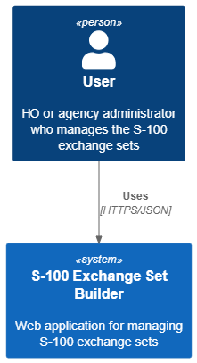
Architecture Strategy
Architecture Overview:
C4 Context diagram

Slide 21
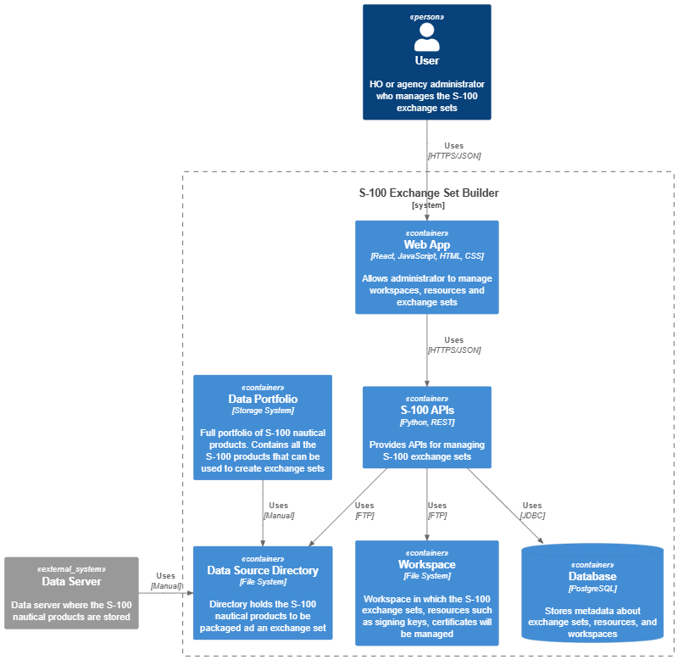
Architecture Strategy
Architecture Overview: C4 Container diagram

Slide 22
Architecture Strategy
Technology Stack:
Java – 17
springboot
React – 18.2.0/ for frontend
jQuery – 3.7.1 / for frontend
Bootstrap – 5.3.3 / for frontend
Docker – 4.36.0
OpenAPI Swagger

Slide 23
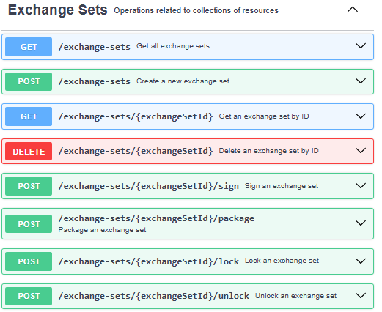
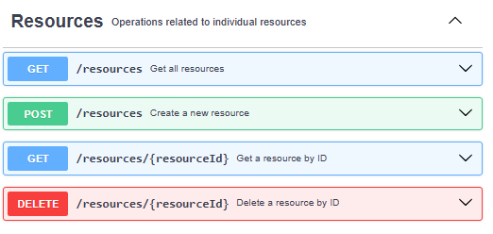
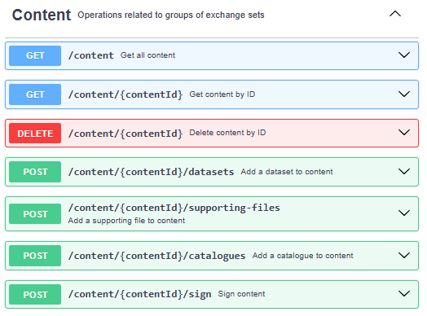
REST APIs

Slide 24
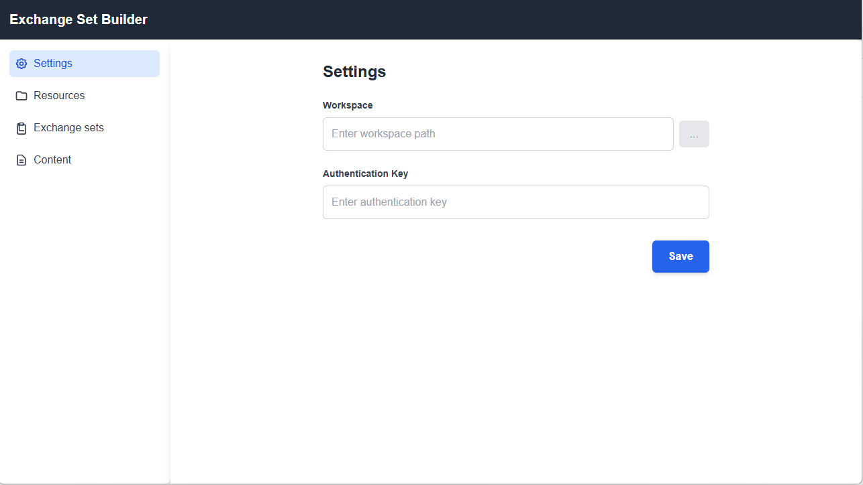
User interface

Slide 25
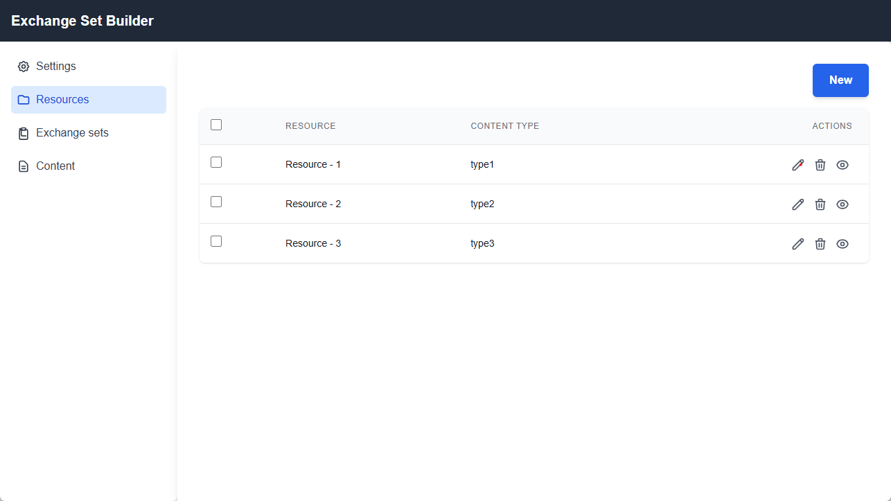

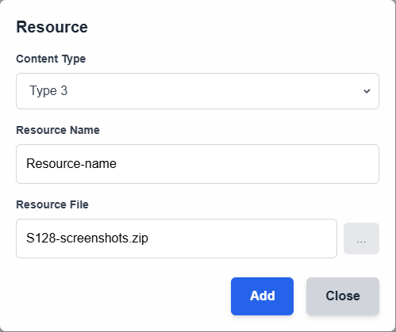
User interface

Slide 26
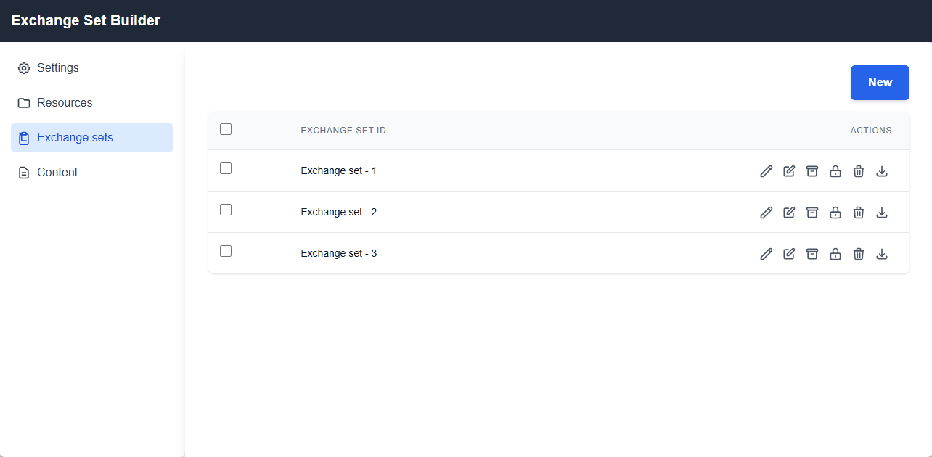


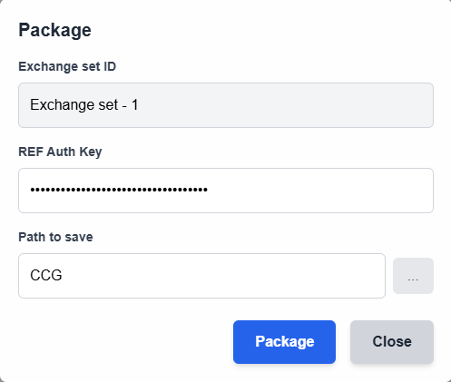
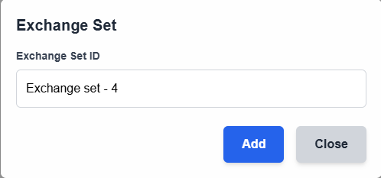
User interface

Slide 27
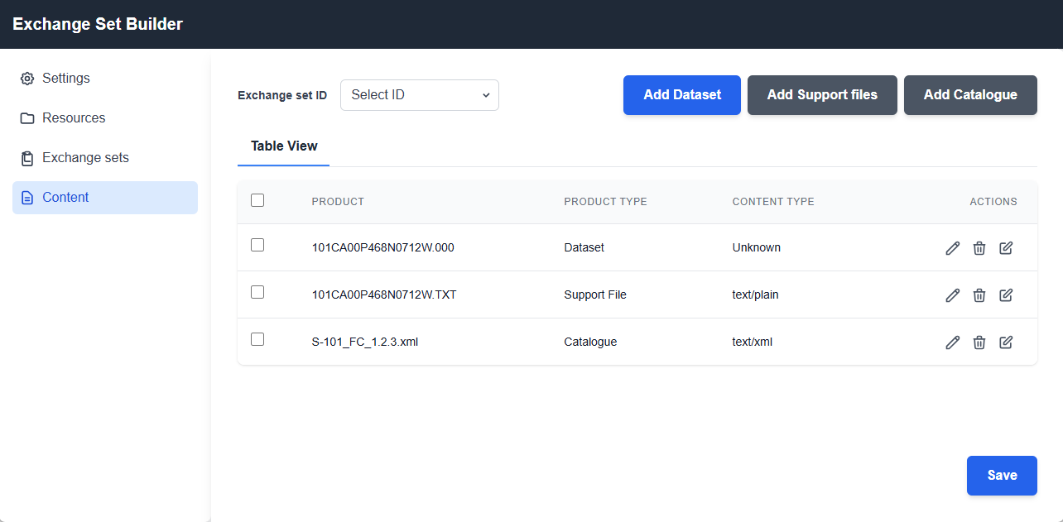
User interface
Exchange set 1

Slide 28
Release Planning
Release Goals: Define the goals for the initial release.
Milestones: Outline key milestones and their expected dates.

Slide 29
Test Strategy
Testing Approach: Describe the testing approach and methodologies.
Quality Assurance: Outline the quality assurance.

Slide 30
Vision Development
Shared Vision: Articulate the shared vision for the project.
Vision Statement: Provide a concise vision statement.

Slide 31
Funding and Resources
Budget Overview: Provide an overview of the project budget.
Resource Allocation: Detail the resources allocated to the project.

Slide 32
Risks and Dependencies
Risk Identification: List potential risks and their impact.
Dependencies: Identify any critical dependencies.

Slide 33
Thank You

